Slide 1
CLUSTER ANALYSIS
Faculty : Dr. Hariharan Rajadurai

Slide 2
Team Members
K.Manoj – 20BAI10334
Purna Chandar - 20BAI10362
B.Sai Srujan - 20MIM10093
Abhinav -20BAI10213

Slide 3
Table of contents
01
02
03
04
05
06
Cluster analysis
Introduction
K-means cluster
Working of K-means cluster
Limitations & Applications
Hierarchical cluster analysis
07
08
09
Working of Hierarchical cluster
Advantages & Limitations
conclusion

Slide 4
Introduction
Deep learning has transformed the area of artificial intelligence by allowing the creation of complicated models capable of completing previously thought-impossible tasks. However, as deep learning models become more advanced, their interpretability and transparency diminish, making it difficult to understand how the model makes judgements. Cluster analysis is a significant method for interpreting and evaluating deep learning models, as it allows for the detection of underlying structures and patterns in data.

Slide 5
Cluster analysis is a technique that groups data points based on their similarities while maximizing the differences between clusters. In the context of deep learning, cluster analysis can aid in the interpretation of models by identifying patterns, trends, and relationships within the data. It can also be used to enhance model performance by identifying potential outliers or errors in the data.

Slide 6
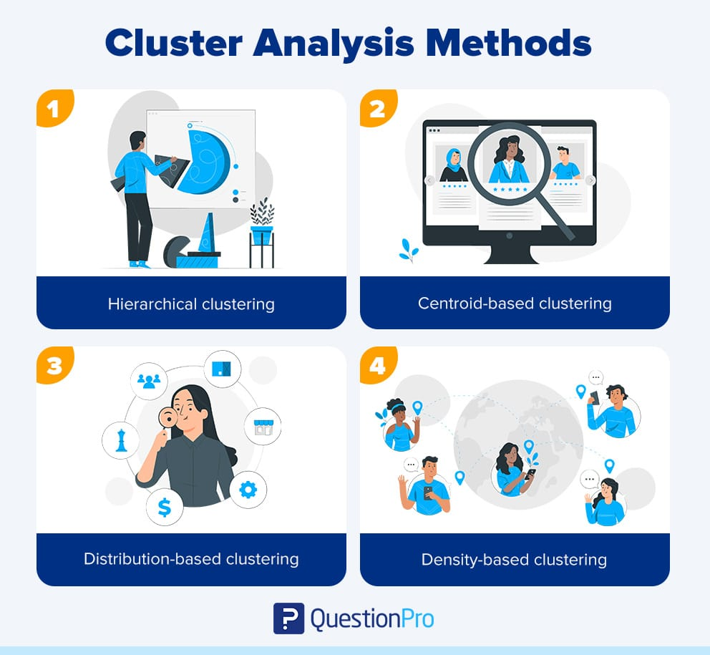
Types of Cluster Analysis

Slide 7
K-means clustering is a popular unsupervised machine learning algorithm used for partitioning a dataset into K distinct clusters. It is widely utilized in various fields, such as data analysis, image segmentation, customer segmentation, and document clustering. K-means aims to group similar data points together while maximizing the dissimilarity between clusters.
K-Means Clustering Analysis

Slide 8
Working of K-means Clustering
Determine the desired number of clusters, K.
Randomly initialize K cluster centroids. Each centroid represents the center of a cluster.
2. Assignment Step:
Assign each data point to the nearest centroid based on a distance metric(commonly the Euclidean distance).
Each data point belongs to the cluster whose centroid is closest to it.
Update Step:
Recalculate the centroids of each cluster by taking the mean of all data points assigned to that cluster.
Move the centroid to the new mean position.
Iteration:
Repeat the assignment and update steps until convergence or a predefined stopping criterion is met.

Slide 9
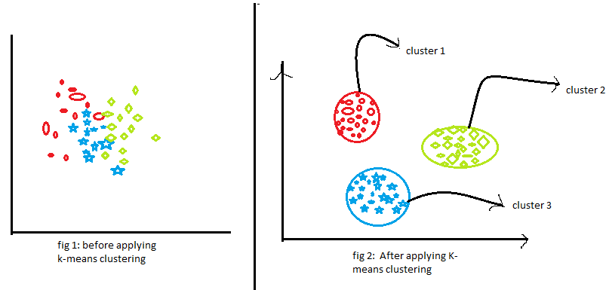
Convergence occurs when the centroids no longer change significantly, or the maximum number of iterations is reached.
Output:
The final result is a set of K clusters, each represented by its centroid.

Slide 10
Limitations
K-means assumes clusters with spherical shapes and similar variances, making it less suitable for complex or non-linear cluster structures.
It is sensitive to the initial centroid placement and can converge to different solutions.
Outliers can significantly impact the clustering results.
The algorithm requires the number of clusters, K, to be specified in advance.

Slide 11
Applications !
K-means clustering has a wide range of applications in various domains. Some of the common applications of K-means clustering include:
Customer segmentation
Image compression and Retrieval
Anomaly Detection
Document Clustering
Market Segmentation
Genetic clustering
Image segmentation

Slide 12
Hierarchical Cluster
Hierarchical clustering is a popular unsupervised machine learning algorithm used for grouping similar data points into clusters based on their similarity or dissimilarity. Unlike K-means clustering, hierarchical clustering does not require specifying the number of clusters in advance. It builds a hierarchy of clusters, which can be represented as a tree-like structure called a dendrogram.

Slide 13
Common methods for updating distances include single linkage (minimum distance), complete linkage (maximum distance), average linkage (average distance), or Ward's method. Hierarchical Structure Construction: Continue merging or dividing clusters until all data points belong to a single cluster (agglomerative) or each data point forms an individual cluster (divisive).The result is a dendrogram, which visually represents the hierarchy of clusters and their relationships. Cluster Selection: Determine the desired number of clusters by selecting a level or cutting the dendrogram at a specific height. The height or level selection depends on the problem domain and the desired granularity of clustering. Assigning Cluster Labels: Assign data points to clusters based on the selected level or height in the dendrogram. Each leaf node in the dendrogram represents a cluster, and the assignment is based on the merging/dividing history.

Slide 14
Working of hierarchical clustering
Distance Calculation:
Determine the similarity or dissimilarity measure (e.g., Euclidean distance, Manhattan distance, cosine similarity) to quantify the distance between data points or clusters.
Initialization:
Treat each data point as an individual cluster.
Agglomeration/Divisive Steps:
Agglomerative Approach: Start with each data point as a separate cluster and iteratively merge the closest clusters based on the defined distance measure.
Divisive Approach: Begin with all data points in a single cluster and recursively divide them into smaller clusters based on the distance measure.
4. Distance Update::
Recalculate the distance between the newly formed clusters or data points based on the chosen similarity or dissimilarity measure.

Slide 15
Advantages:
No predefined number of clusters: Hierarchical clustering automatically determines the number of clusters based on the data and the chosen dendrogram level.
Visualization: The dendrogram provides a visual representation of the clustering hierarchy, enabling a comprehensive understanding of the relationships between clusters and data points.
Flexibility: Hierarchical clustering can handle various types of data and distance/similarity measures, making it adaptable to different domains.

Slide 16
Limitations:
Computationally expensive: The algorithm's time and memory requirements increase with the number of data points, making it less suitable for large datasets.
Sensitivity to outliers: Hierarchical clustering can be sensitive to outliers, as it tends to merge clusters based on proximity, potentially impacting the overall clustering structure.
Difficulty in handling large datasets: Scaling hierarchical clustering to large datasets can be challenging due to its inherent hierarchical structure construction process.

Slide 17
Conclusion
In conclusion, cluster analysis is a powerful technique in unsupervised machine learning that helps uncover patterns and structures within data.
Both K-means clustering and hierarchical clustering have their strengths and weaknesses. K-means clustering is efficient and suitable for large datasets, while hierarchical clustering offers flexibility and interpretability but can be computationally expensive for large datasets.

Slide 18
Overall, cluster analysis, whether through K-means clustering or hierarchical clustering, is a valuable tool for data exploration, pattern recognition, and decision-making. These techniques enable us to understand the inherent structure of data, identify meaningful groups, and gain insights that can drive informed actions.

Slide 19
Code Explanation
import numpy as np
import matplotlib.pyplot as plt
import pandas as pd
Pandas:
Pandas is a versatile data manipulation and analysis library in Python. The line import pandas as pd imports the Pandas library and assigns it the alias "pd" for ease of use.
NumPy:
NumPy is a powerful library for numerical computations in Python. The line import numpy as np imports the NumPy library and assigns it the alias "np" for easier reference in the code.
Matplotlib:
Matplotlib is a popular data visualization library in Python. The line import matplotlib.pyplot as plt imports the pyplot module from the Matplotlib library and assigns it the alias "plt" for convenience.

Slide 20
Randomly choosing the K centroids for the initial clusters from the dataset
def kMeans_init_centroids(X, K):
rand_idx = np.random.permutation(X.shape[0])
init_centroids = X[rand_idx[:K]]
return np.array(init_centroids)
rand_idx[:K] selects the first K shuffled indices from rand_idx.
X[rand_idx[:K]] retrieves the corresponding data points from X using the selected indices.
The selected data points are stored in the init_centroids variable.
These data points will serve as the initial centroids for the k-means algorithm.
return np.array(init_centroids):
The function returns the initial centroids as a NumPy array.
In summary, the kMeans_init_centroids function takes a dataset X and the desired number of centroids K as input. It shuffles the indices of the data points and selects the first K shuffled indices to initialize the centroids. Finally, it returns the selected data points as the initial centroids in the form of a NumPy array.
rand_idx = np.random.permutation(X.shape[0]):
The np.random.permutation function shuffles the indices of the input data X.
X.shape[0] returns the number of rows in X, which represents the number of data points.
The rand_idx variable will store the shuffled indices of the data points.

Slide 21
Assigning each data point to their nearest centroid.
def assigning_points_to_centroids(x,centroids):
m,n = x.shape k = centroids.shape[0] index = []
for i in range(m): distance = []
for j in range(k):
distance.append(np.linalg.norm(x[i]-centroids[j]))
index.append(np.argmin(distance)) return np.array(index)
istance.append(np.linalg.norm(x[i]-centroids[j])):
np.linalg.norm computes the Euclidean distance between the data point (x[i]) and the centroid (centroids[j]).
The calculated distance is appended to the distance list.
index.append(np.argmin(distance)):
np.argmin returns the index of the minimum value in the distance list, which represents the index of the nearest centroid.
The index is appended to the index list, indicating the assigned centroid for the current data point.
The assigning_points_to_centroids function takes a dataset x and an array of centroids as input. It calculates the Euclidean distance between each data point and each centroid and assigns the data point to the nearest centroid.
The function returns an array of assigned centroid indices for each data point.

Slide 22
Updating centroid locations based on the locations of the data points
def recomputing_centroids(x,index,k): n = x.shape[1] new_centroids = [] for j in range(k): points_related_to_cluster_j = x[index == j] new_centroids.append(np.mean(points_related_to_cluster_j, axis = 0))
The function recomputing_centroids takes x, index, and k as inputs.
It initializes an empty list new_centroids to store the new centroid values.
It iterates through each cluster index j from 0 to k-1.
It selects the data points related to cluster j by filtering x using the condition index == j.
It calculates the mean of the selected data points along the rows and obtains the centroid of cluster j.
The calculated centroid is appended to the new_centroids list.
After the loop, the function converts new_centroids to a NumPy array.
Finally, the function returns the array of new centroids.
In summary, the code computes new centroids for a clustering algorithm by iterating through each cluster index, selecting the relevant data points, calculating their mean, and storing the resulting centroids in an array.

Slide 23
Running the algorithm(repeting [fist & second] step n times )
It starts a loop that iterates max_iters times.
Inside the loop, it assigns data points to centroids using the assigning_points_to_centroids function and obtains the indices indx indicating which cluster each point belongs to.
It recomputes the centroids using the recomputing_centroids function, passing X, indx, and k as inputs.
It updates the variable z with the new centroids.
If the current iteration number i is divisible by 5 (i%5 == 0), it prints the current iteration number and the values of the centroids.
After the loop, the function returns the final centroids as a NumPy array (np.array(centroids)) and the indices indicating which cluster each data point belongs to as a NumPy array (np.array(indx)).
def run_kMeans(X, initial_centroids, max_iters): k = initial_centroids.shape[0] z = initial_centroids for i in range(max_iters): indx = assigning_points_to_centroids(X, z) centroids = recomputing_centroids(X,indx,k) z = centroids if i%5 == 0: print('iteration{}/{} ====>{} \n'.format(i,max_iters,list(z))) return np.array(centroids),np.array(indx)
The function takes three arguments:
X: A data matrix with shape (m, n), representing m data points with n features.
initial_centroids: An array of shape (k, n) representing the initial centroids for the k clusters.
max_iters: The maximum number of iterations to run the k-means algorithm.
It initializes the variable k to the number of clusters (k) based on the shape of initial_centroids.
It sets the variable z to the initial centroids.

Slide 24
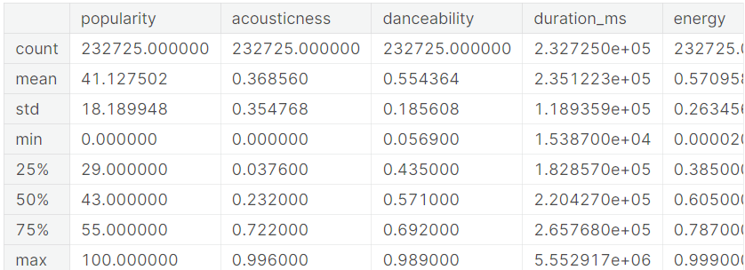
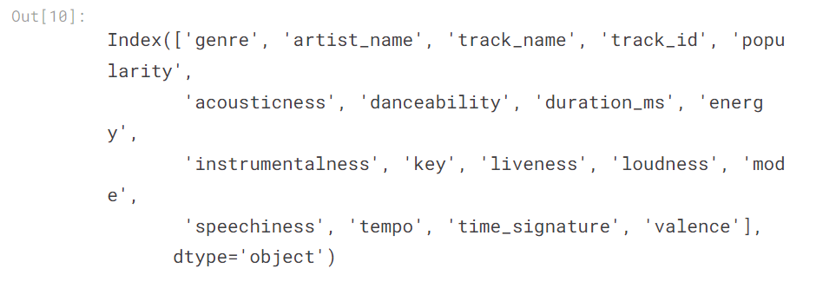
DATa Preprocessing
Data.describe()----gives the statistical overview of the data
Data.columns-------------gives the names of all columns
Loading data set :
data = pd.read_csv("/kaggle/input/ultimate-spotify-tracks-db/SpotifyFeatures.csv")
data.head(20)------gives top 20 rows of the dataset
data.info()-------gives the rangeindex,datatypes,memory usage etc

Slide 25
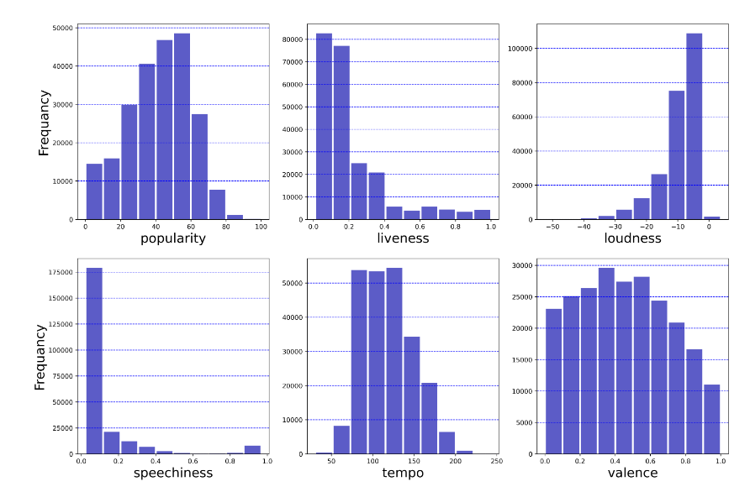
Frequency distribution for some features
features = ['popularity', 'liveness', 'loudness','speechiness','tempo', 'valence']
l = len(features)
plt.figure(figsize=(18,12),dpi = 400)
for i in range (l):
plt.subplot(2,3,i+1)
plt.hist(data[features[i]],color='#0504aa',alpha = 0.65,rwidth=0.9)
plt.xlabel(features[i],size = 20)
if i == 0 or i == 3:
plt.ylabel("Frequancy",size = 20)
plt.xticks()
plt.yticks()
plt.grid(axis = "y" , linestyle = "--",color = "b")
The code plots a histogram for each feature in the features list.
It creates a figure with a specified size and resolution.
For each feature, it generates a histogram with colored bars.
The x-axis label is set to the name of the current feature.
The y-axis label is set to "Frequency" for the first and fourth histograms, and the y-axis gridlines are added.
In summary, the code creates histograms for the given features, customizes the plot appearance, and labels the axes.

Slide 26
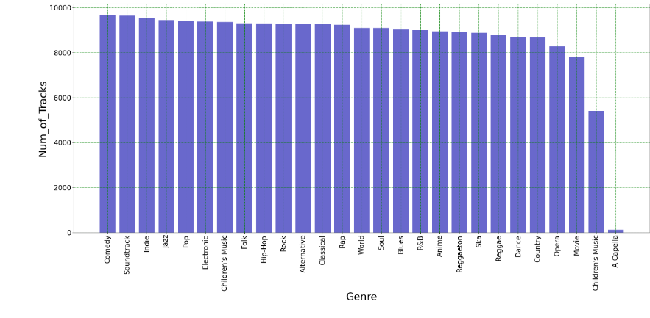
A bar plot is created to visualize the number of tracks in each genre using plt.bar(). The x-axis represents the genre categories, and the y-axis represents the count of tracks.
The plot is customized by setting the x-axis label, y-axis label, and their font sizes using plt.xlabel(), plt.ylabel(), plt.xticks(), and plt.yticks(). Additionally, the x-axis tick labels are rotated vertically for better readability.
Gridlines are added to the plot using plt.grid() with a dashed linestyle and green color.
Finally, the plot is displayed using plt.show().
In summary, the code groups the data by genre, counts the number of tracks in each genre, and creates a bar plot to visualize the count of tracks for each genre. The plot is customized with labels, gridlines, and appropriate formatting.
df0 = pd.DataFrame(data.groupby(data["genre"]).count()["track_id"]).reset_index()
df0 = df0.sort_values(by="track_id",ascending=False)# Plotting no.of tracks in each category
plt.figure(figsize= (30,12))
plt.bar(df0["genre"],df0["track_id"],color = '#0504aa',alpha = 0.6)
plt.xlabel("Genre",size = 30)
plt.ylabel("Num_of_Tracks",size = 30)
plt.xticks(size = 20,rotation='vertical')
plt.yticks(size = 20)
plt.grid(linestyle = '-.',c = "g")
plt.show()
This code performs the following operations:
The data is grouped by the "genre" column, and the count of "track_id" is calculated for each group using groupby() and count().
The resulting grouped data is stored in a DataFrame called df0 and reset the index.
The DataFrame df0 is sorted in descending order based on the "track_id" column using sort_values().

Slide 27
THANK YOU

